Slide 1

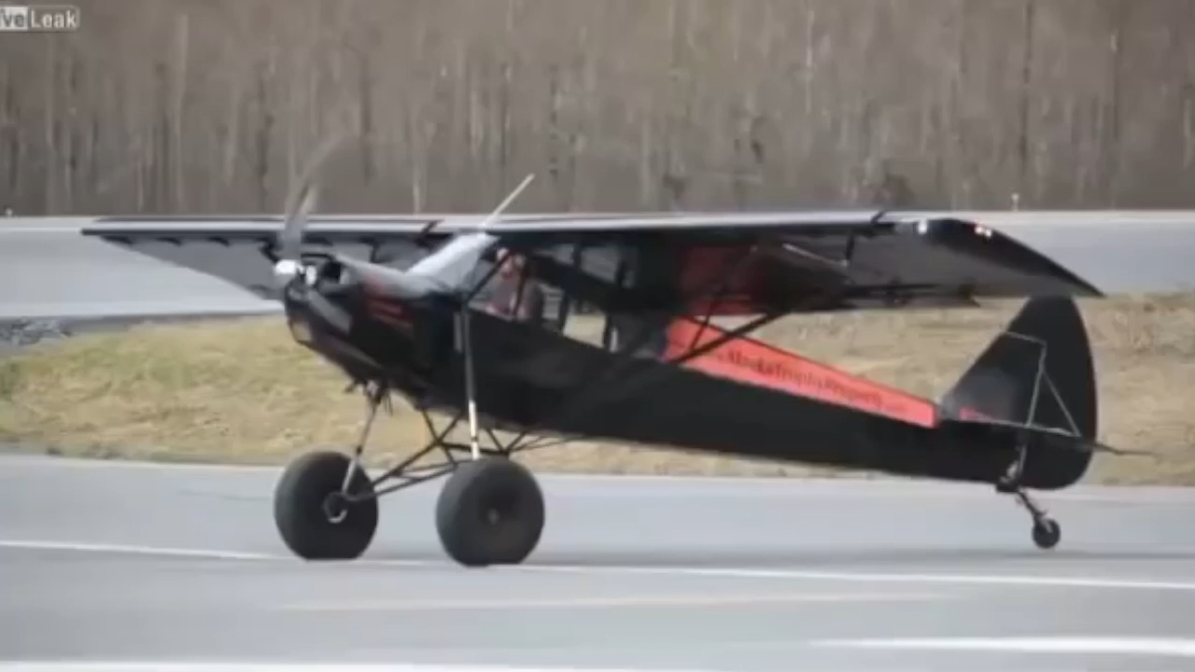
Abridged Transition and Climb Dynamics
for
High Power/Weight Aircraft
Dynamics
Roll
Transition
Climb

Slide 2
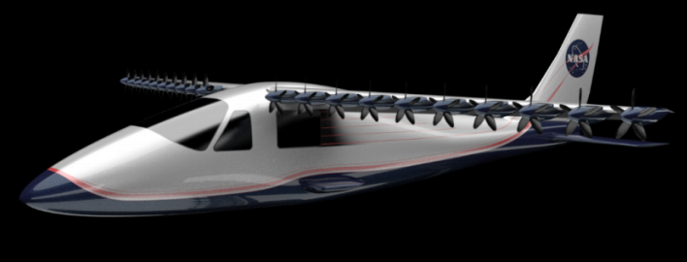
Motivation: Design Optimization
Design & Full Dynamics
Design & Abridged Dynamics
VS
45,000,000 calls
40,000 calls
1125x Faster

Slide 3

Comparison
Dynamic Takeoff Optimization
Abridged Dynamic Equations

Slide 4
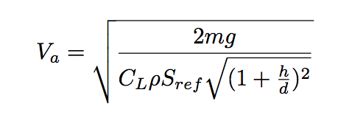
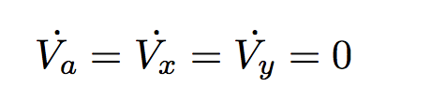
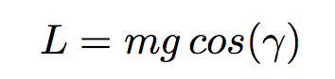
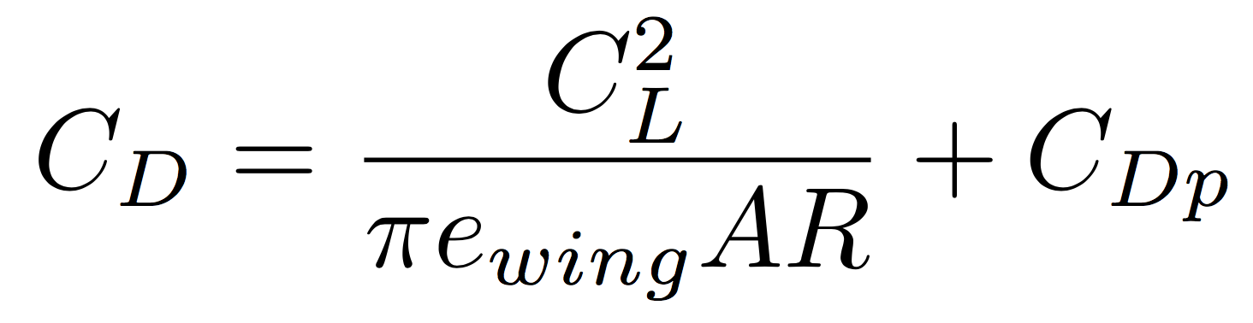
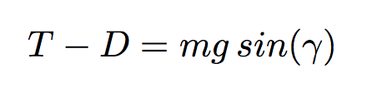
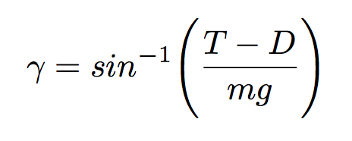
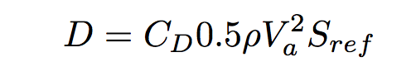
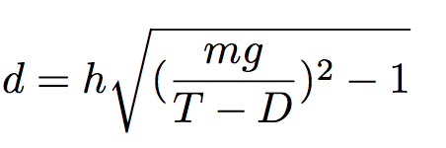
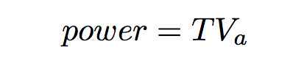
Steady Climb Derivation
Basics
Include Drag Variation

Slide 5
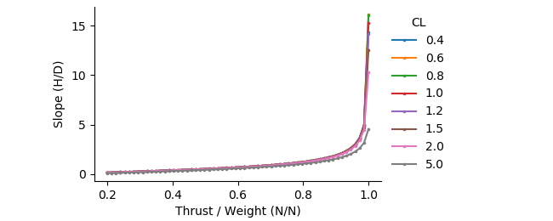
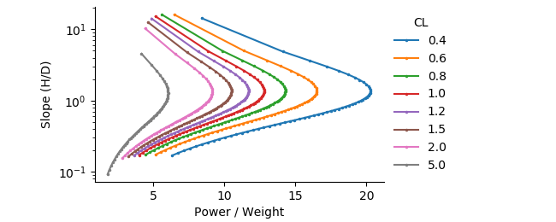
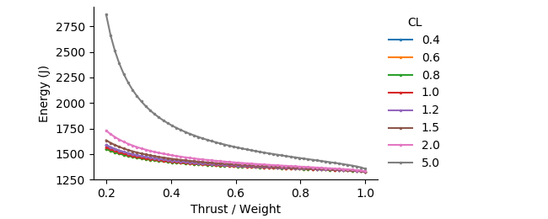
Thrust Slope
CL Power
CL Energy

Slide 6

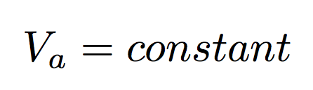
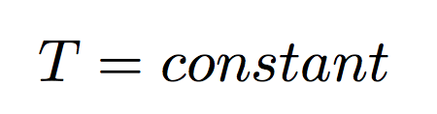
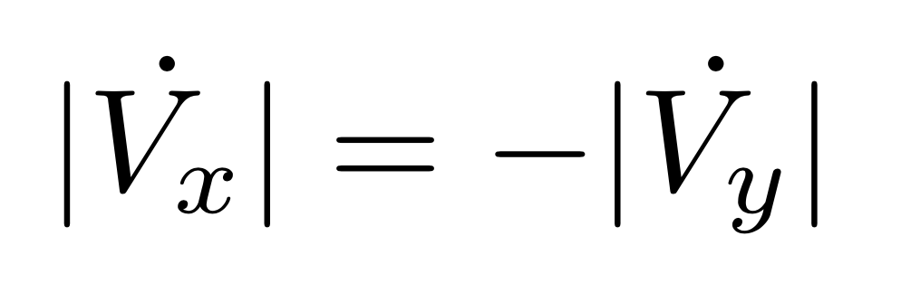
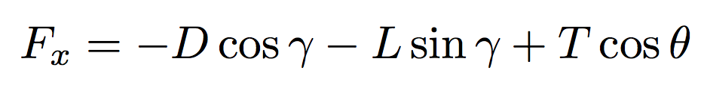
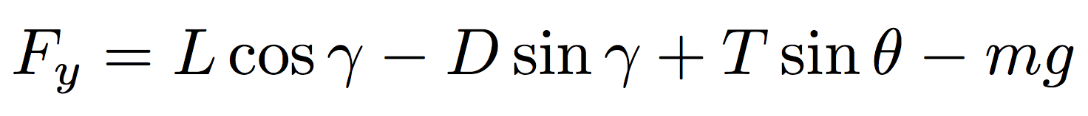
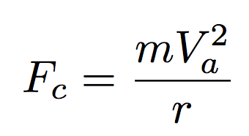
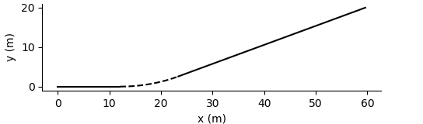
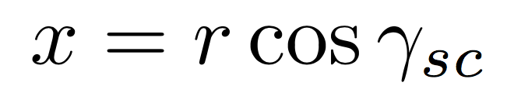
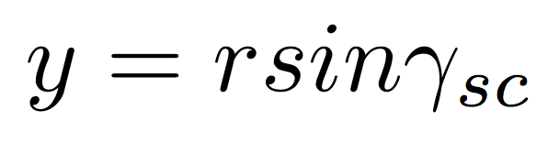
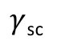
Transition Derivation
Centrifugal Force
$γ$_{sc}

Slide 7
Thrust or Power Transition %

Slide 8

Dynamic Takeoff Optimization
Takeoff Path
McLain/Beard Dynamics
Aerosonde Parameters
30 Control Points -> Elevator, Thrust
Constrain: Max Power, Min Velocity, Min and Max Altitude
Minimize: Total Energy
17 | 1.0

Slide 9
Timed Momentum Buildup Optimal

Slide 10
Simple Dynamics Comparison: Path

Slide 11
Simple Dynamics Comparison: Energy

Slide 12
Summary / Questions
Design & Full Dynamics
Design & Abridged Dynamics
VS
45,000,000 calls
40,000 calls
1125x Faster

